Slide 1


Mathematical Logic and Reasoning
LECTURE 4
Adapted from :
https://www.genrica.com/vustuff/MTH202/MTH202_handouts_1_45.pdf

Slide 2
Learning Outcomes
After completing this lecture satisfactorily, a student will:
• Be able to construct simple mathematical proofs and possess
the ability to verify them.
Have substantial experience to comprehend formal logical
arguments.
• Be skillful in expressing mathematical properties formally via
the formal language of propositional logic and predicate logic.

Slide 3
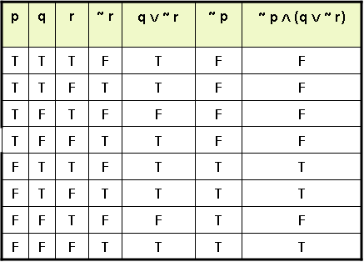

Slide 5
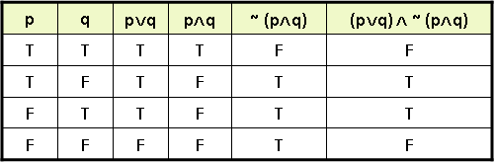
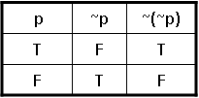

Slide 6
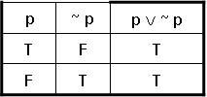

Slide 10
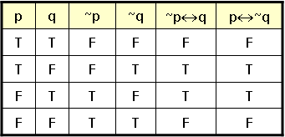

Slide 15
Review Questions
What is Tataulogy
Difference between tautology and contradiction.

Slide 16
Thank you

